Slide 1
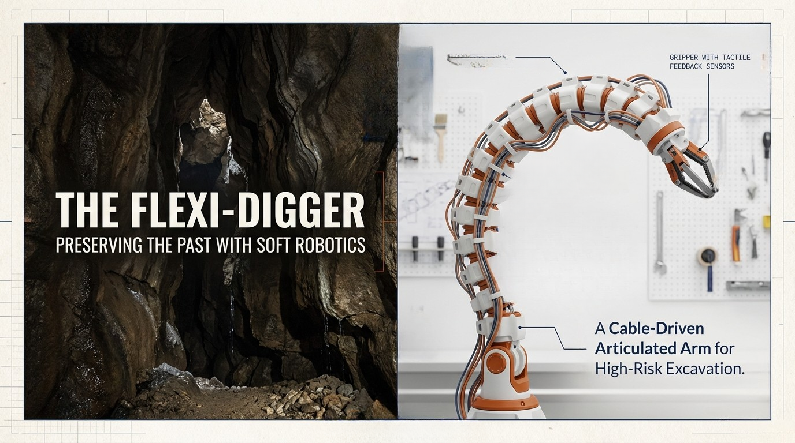
VERTEBRAE MODULE
TEAM EXCAVATORS | INNOVATION PROJECT ( Luke Smith, Silas Arsenault, Nelson Sage )

Slide 2
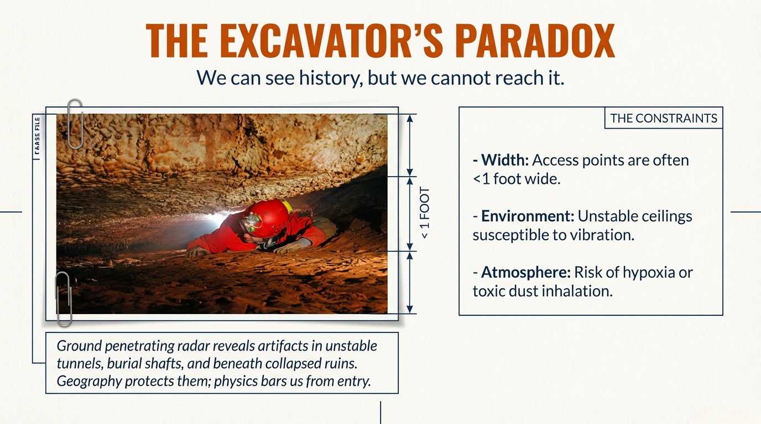

Slide 3
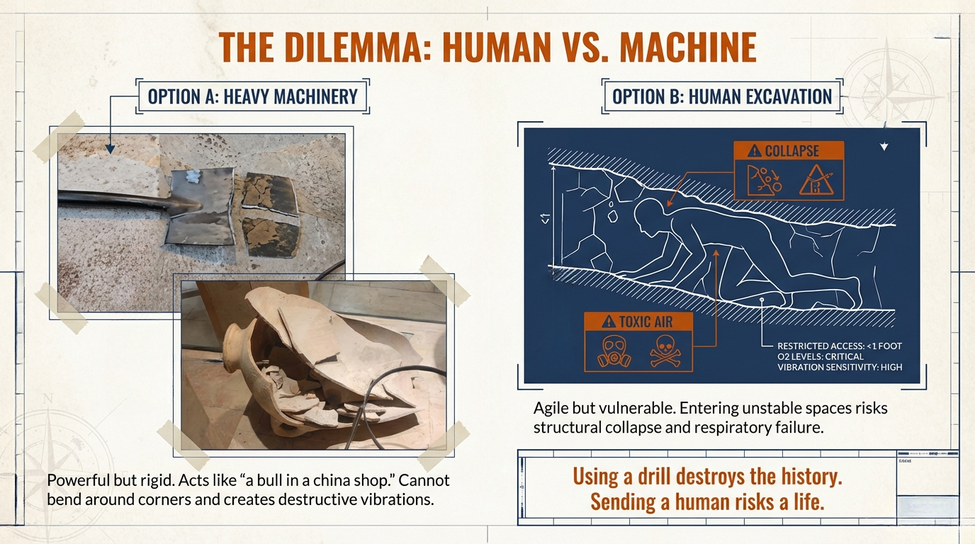

Slide 4
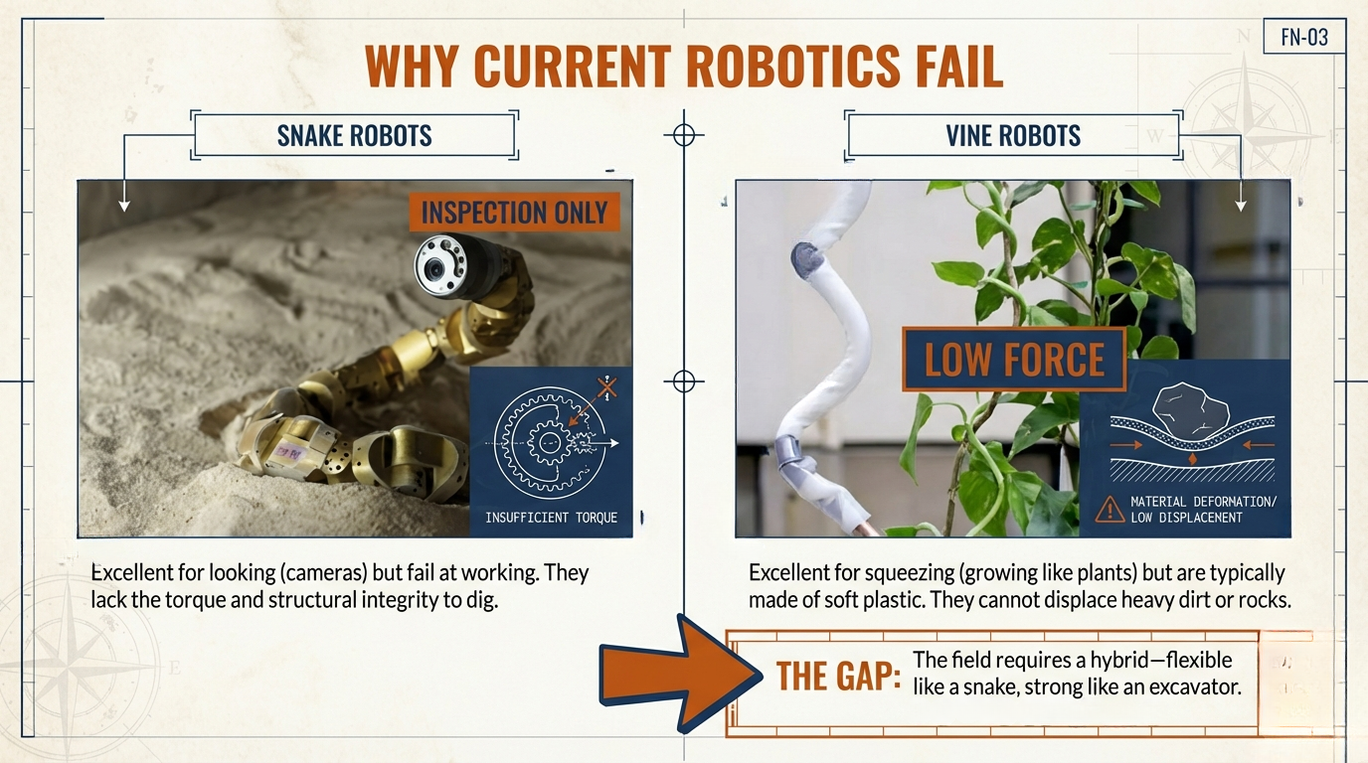

Slide 5
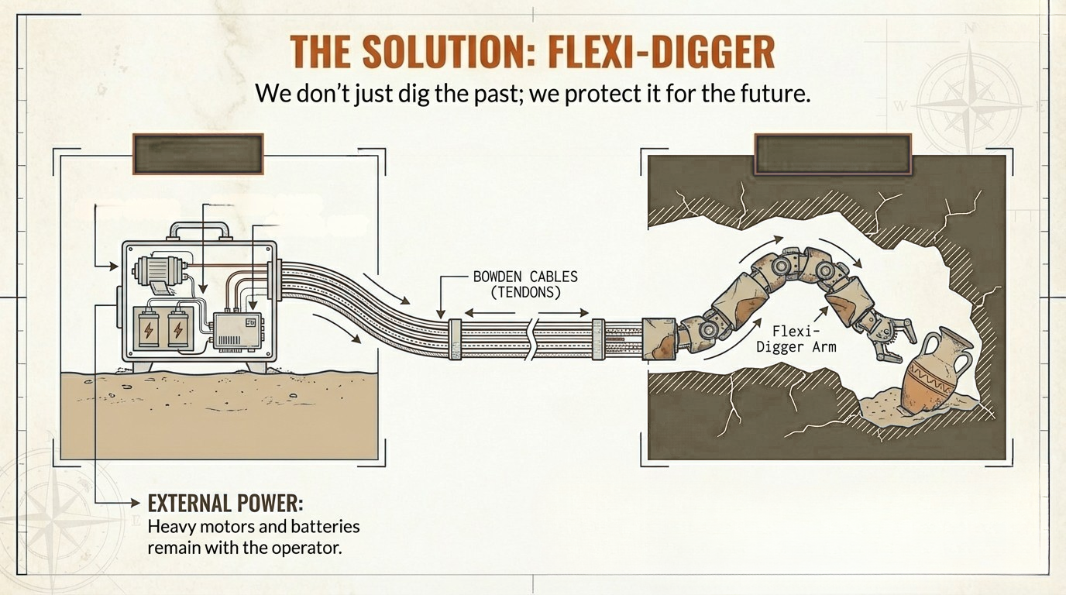
control zone
danger zone
large motors
battery pack
control unit

Slide 6
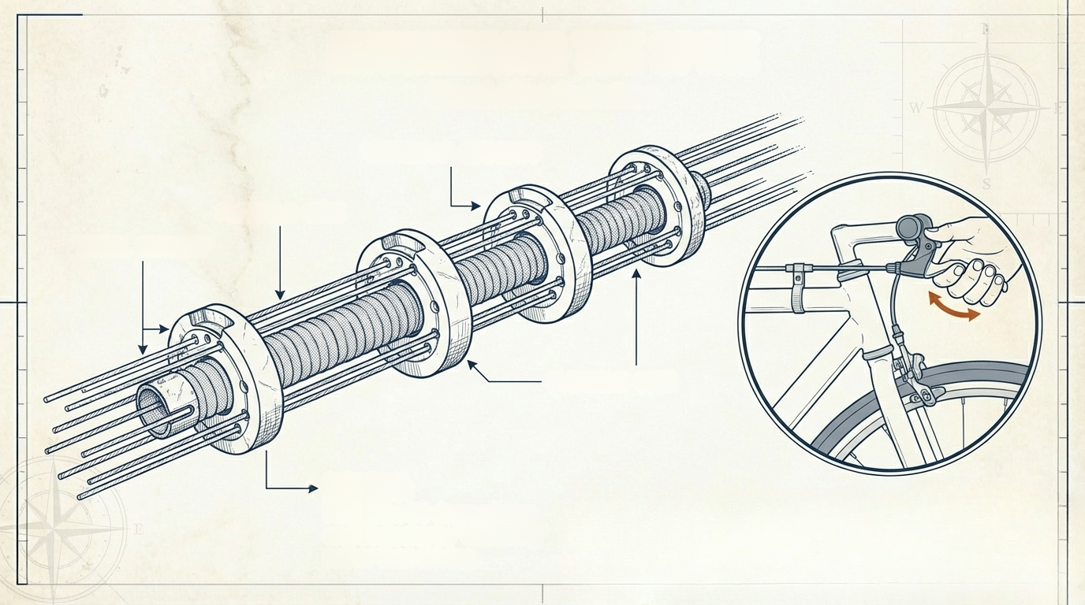
ENGINEERING THE SPINE
bionics in Action
VERTEBRAE SEGMENTS
flexable core
steel tendons
FLEXIBLE CORE
BENEFIT
Navigates 90-degree turns
and obstacles by "slithering"
rather than driving.

Slide 7
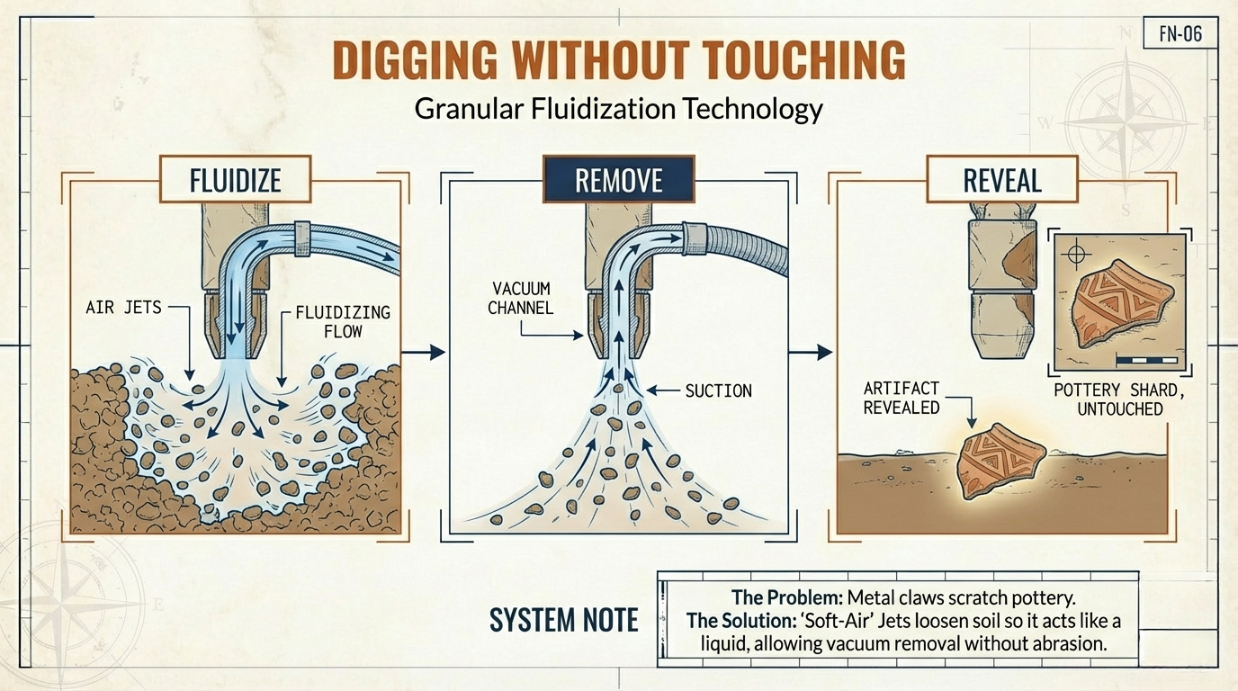

Slide 8
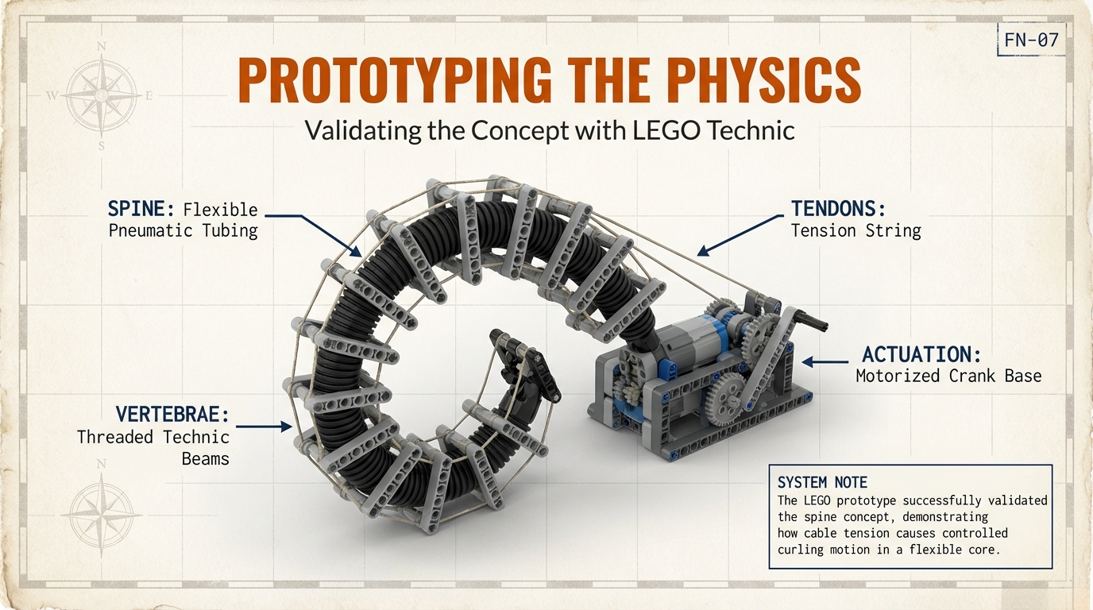

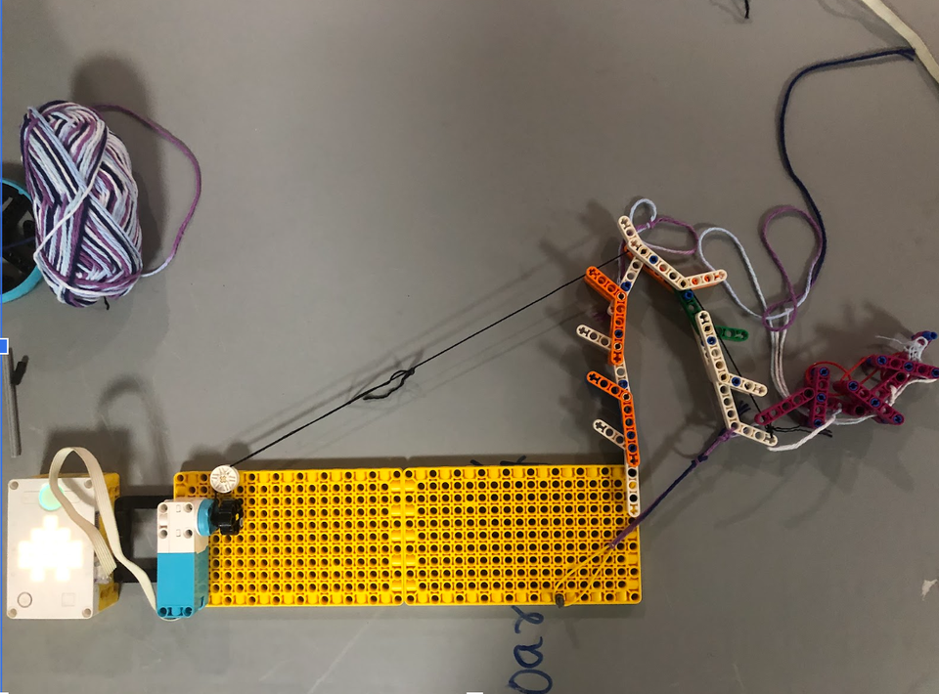
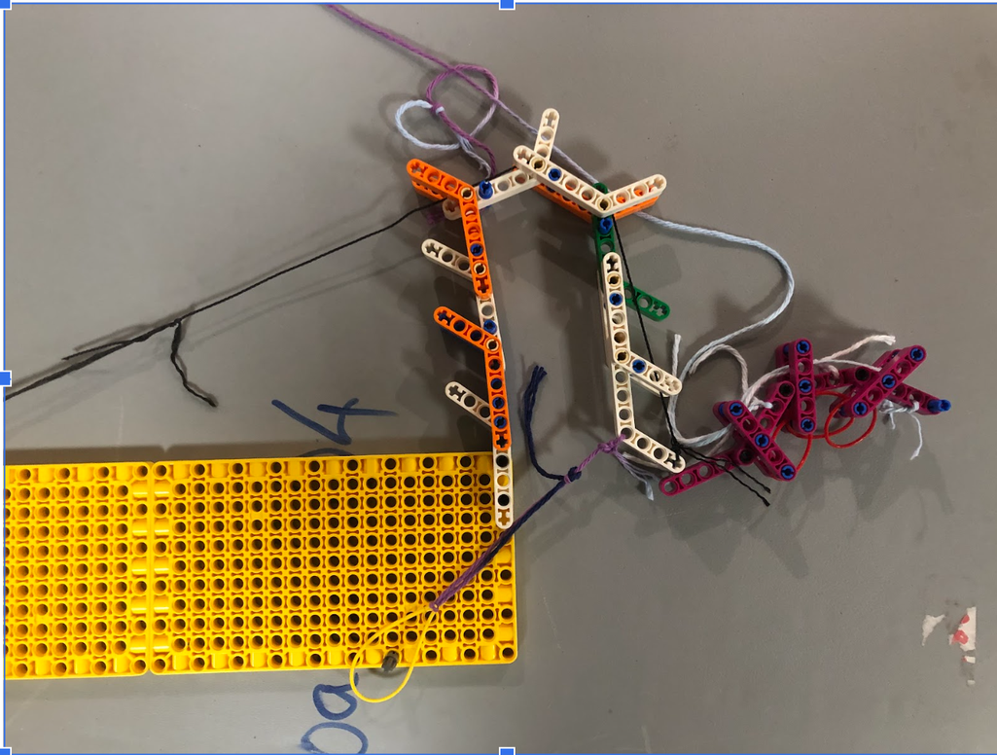

Slide 9
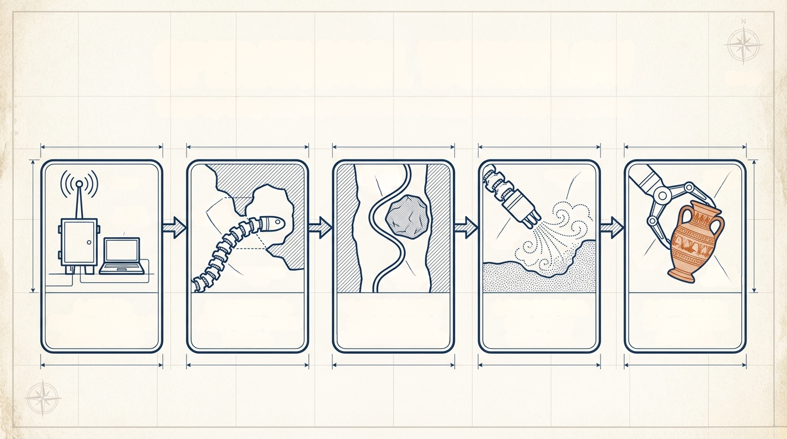
OPERATIONAL WORKFLOW
Step-by-Step Deployment and Artifact Recovery Sequence
OBSTACLE
AVOIDANCE
PATH
FLUIDIZATION
ZONE
ARTIFACT
SECURED
PASSAGE
DIAMETER
AIR FLOW
RATE
GENTLE
GRIP
FLEXI-DIGGER
UNIT
OPERATOR
INPUT
GENTLE
GRIP FORCE
1. SETUP:
Station established
outside tunnel.
2. INSERTION
Flexi-Digger enters
3. NAVIGATION:
Operator guides
spine around obstacles.
4. EXCAVATION:
Soft-Air jets
fluidize soil.
5. RETRIEVAL:
Safe extraction
of artifact.
passage.

Slide 10
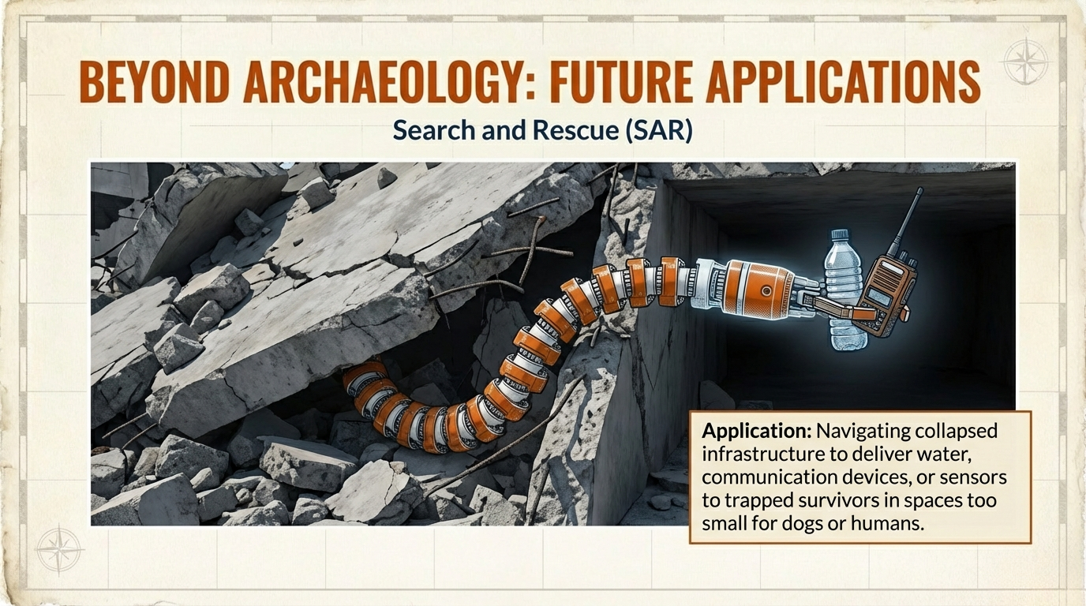

Slide 11
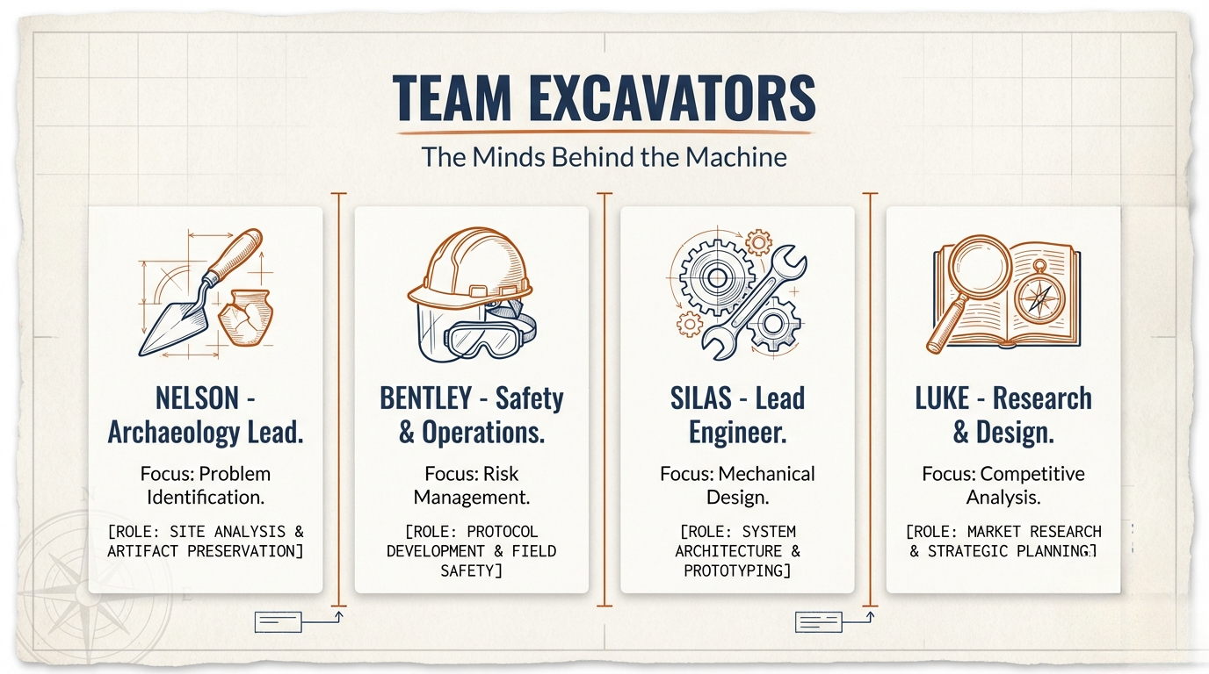
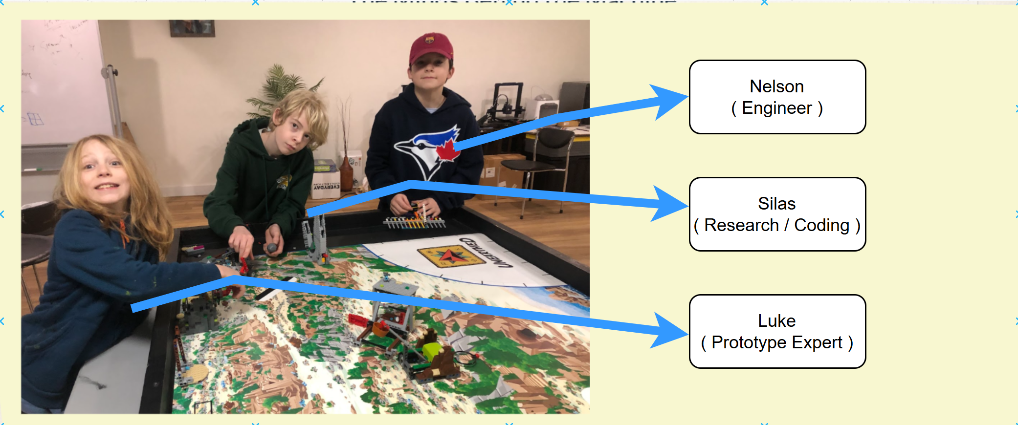

Slide 12
